Slide 1
Genome Editing: Pathways to Translation
George Q. Daley, MD, PhD
Member, Organizing Committee
2nd International Summit on Human Genome Editing
November 28, 2018
Hong Kong

Slide 2
Statement of Organizing Committee 2015
Basic and clinical research:
Endorsed basic and preclinical research on gene editing, including in human embryos and germ cells, subject to legal and ethical oversight:
“If, in the process of research, early human embryos or germline cells undergo gene editing, the modified cells should not be used to establish a pregnancy.”
Clinical use:
Somatic: Clinical translation can proceed under existing regulatory frameworks;
Germline: Editing poses risks, including inaccurate editing and difficulty predicting harmful effects; “It would be irresponsible to proceed with any clinical use …”

Slide 3
Genome Editing Clinical Trials (ZFNs)
Sponsor | NCT Number(s) | Year | Country | Disease | Gene Target | Nuclease | Ex vivo vs In vivo | Delivery | Pre-Clinical Publication | Clinical Publication
Penn/ Sangamo | 00842634 | 2009 | USA | HIV | CCR5 | ZFN | Ex Vivo (T-Cell) | Electroporation (mRNA) | Perez et al NBT (2005) | Tebas et al NEJM (2014)
UCLA/UCSF Sangamo | 01252641 01044654 | 2010 | USA | HIV | CCR5 | ZFN | Ex Vivo (T-cell) | Electroporation (mRNA) | Perez et al NBT (2005)
City of Hope/ Sangamo | 02500849 | 2015 | USA | HIV | CCR5 | ZFN | Ex Vivo (HSPC) | Electroporation (mRNA) | Digiusto et al MTMCD (2016) Holt et al NBT (2010)
Sangamo | 02695160 02702115 03041324 | 2016-2017 | USA | Hem B MPS-I MPS-II | Albumin | ZFN | In vivo (liver) | AAV | Sharma et al Blood (2015)
Bioverativ/ Sangamo | 03653247 | 2018 | USA | Sickle Cell Disease | BCL11A (erythroid enhancer) | ZFN | Ex Vivo (HSPC) | Electroporation (mRNA) | No
Sangamo/ Bioverativ | 03432364 | 2018 | USA | β-Thal | BCL11A (erythroid enhancer) | ZFN | Ex Vivo (HSPC) | Electroporation (mRNA) | No

Slide 4
Genome Editing Clinical Trials (TALENs)
Sponsor | NCT Number(s) | Year | Country | Disease | Gene Target | Nuclease | Ex vivo vs In vivo | Delivery | Pre-Clinical Publication | Clinical Publication
Servier/ Allogene | 02808442 (peds) 02746952 (adult) | 2016 | USA Europe | ALL | TCR CD52 | TALEN | Ex Vivo (CART-19) | mRNA | Poirot et al CCR (2015) | Qasim et al STM (2016)
Cellectis | 03203369 | 2017 | USA | BPDCN | TCR CD52 | TALEN | Ex Vivo (CART-123) | mRNA
Cellectis | 03190278 | 2017 | USA | AML | TCR CD52 | TALEN | Ex Vivo (CART-123) | mRNA
Sun Yat-sen | 03057912 | 2017 | China | HPV | HPV E6/E7 | TALEN or Cas9/gRNA | In vivo | Plasmid/Gel
Huazhong University of Science and Technology | 03226470 | 2017 | China | HPV | HPV E6/E7 | TALEN | In vivo | Plasmid/ Polymer Gel | Hu et al JCI (2015)

Slide 5
Genome Editing Clinical Trials (CRISPR/Cas9)
Sponsor | NCT Number(s) | Year | Country | Disease | Gene Target | Nuclease | Ex vivo vs In vivo | Delivery | Pre-Clinical Publication | Clinical Publication
Peking University (Cell Biotech) | 02863913 02867345 02867332 | 2016 | China | Bladder Prostate Renal Cell | PD-1 | Cas9/gRNA | Ex Vivo (T-cells)
Affiliated Hospital to Academy of Military Medical Sciences | 03164135 | 2017 | China | HIV | CCR5 | Cas9/gRNA | Ex Vivo (HSPC)
Chinese PLA General Hospital | 03166878 | 2017 | China | ALL/ Lymphoma | TCR B2M | Cas9/gRNA | Ex Vivo (CART-19)
Shanghai Bioray Laboratory Inc. | 03229876 | 2017 | China | ALL | TCR HLA-1 | Cas9/gRNA | Ex vivo (CART-19)
UPenn/ Tmunity | 03399448 | 2018 | USA | Multiple Myeloma | TCRα TCRβ PD-1 | Cas9/gRNA | Ex Vivo (CART-NY-ESO) | mRNA
Chinese PLA General Hospital (Weidong Han) | 03398967 | 2018 | China | ALL/ Lymphoma | TCR | Cas9/gRNA | Ex Vivo (CART-19/22)
CRISPR/Vertex | 03655678 | 2018 | Europe | β-Thal | BCL11A (erythroid enhancer) | Cas9/gRNA | Ex vivo (HSPC) | RNP
CRISPR/Vertex |  | 2018 | USA | Sickle Cell Disease | BCL11A (erythroid enhancer) | Cas9/gRNA | Ex vivo (HSPC) | RNP
Baylor | 03690011 | 2018 | USA | T-ALL | CD7 | Cas9/gRNA | Ex Vivo (CART-CD7)
Chinese PLA General Hospital | 03545815 | 2018 | China | Solid Tumors | TCR PD-1 | Cas9/gRNA | Ex Vivo (CART-mesothelin)

Slide 6
Lessons from trials of somatic genome editing
Current mechanisms for trial oversight has ensured safety, rigor
Trade-offs: cumbersome, expensive, conservative, slow…

Slide 7
Statement of Organizing Committee 2015
“It would be irresponsible to proceed with any clinical use of germline editing unless and until…”
Safety/ efficacy established after further pre-clinical research;
There is broad societal consensus about appropriateness of the application;
Only under appropriate regulatory oversight.
“At present, these criteria have not been met for any proposed clinical use…
“As scientific knowledge advances and societal views evolve, the clinical use of germline editing should be revisited on a regular basis.”
Ongoing forum: “The international community should strive to establish norms concerning acceptable uses of human germline editing and to harmonize regulations in order to discourage unacceptable activities while advancing human health and welfare”

Slide 8

…Since 2015
May 2016 – International Society for Stem Cell Research
Guidelines Call for EMBRYO RESEARCH OVERSIGHT- EMRO
Recommendation 2.1.1: All research that (a) involves preimplantation stages of human development, human embryos, or embryo-derived cells or (b) entails the production of human gametes in vitro when such gametes are tested by fertilization or used for the creation of embryos shall be subject to review, approval, and ongoing monitoring by a specialized human embryo research oversight (EMRO) process capable of evaluating the unique aspects of the science.
Rec 2.1.4: “The ISSCR supports laboratory-based research that entails modifying the nuclear genomes of gametes, zygotes and/or preimplantation human embryos, performed under a rigorous EMRO process…
“Until further clarity emerges on both scientific and ethical fronts, the ISSCR holds that any attempt to modify the nuclear genome of human embryos for the purpose of human reproduction is premature and should be prohibited at this time.”

Slide 9

…Since 2015
February 2017-- US NAS/NAM
“Human Genome Editing: Science, Ethics, Governance”
“basic research involving both somatic and germline cells is essential to the advancement of science and should continue with existing regulatory structures.”
”clinical trials of genome editing in somatic cells for the treatment or prevention of disease or disability should continue, subject to the ethical norms and regulatory frameworks that have been developed for existing somatic gene therapy research and clinical use”
“Given both the technical and societal concerns, the committee concludes there is a need for caution in any move toward germline editing, but that caution does not mean prohibition. It recommends that germline editing research trials MIGHT be permitted, but only after much more research to meet appropriate risk/benefit standards for authorizing clinical trials.”

Slide 10

…Since 2015
July 2018- Nuffield Council on Bioethics
—Genome Editing and Human Reproduction
”We can, indeed, envisage circumstances in which heritable genome editing interventions SHOULD be permitted.”

Slide 11

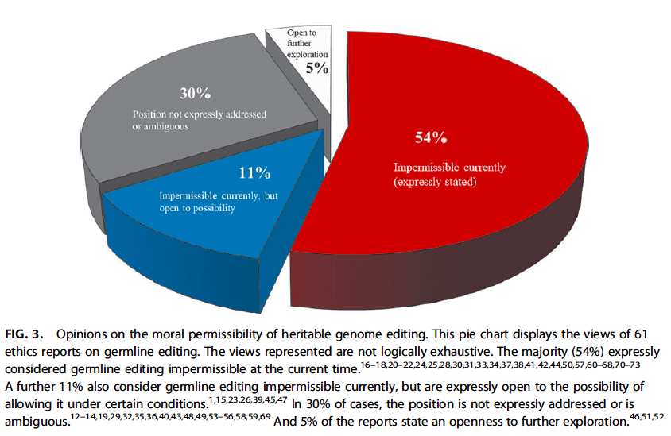
>60+ Reports on Human Genome Editing (2015-2018) Brokowski, C The CRISPR Journal 2018

Slide 12
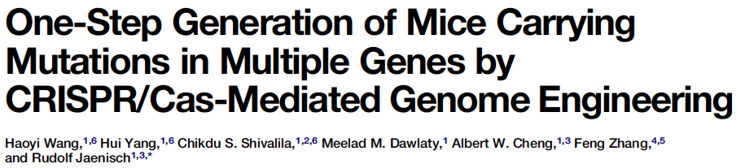
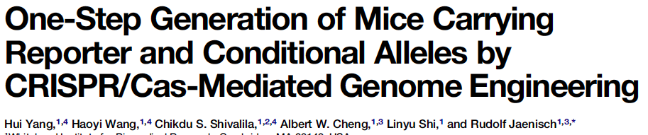
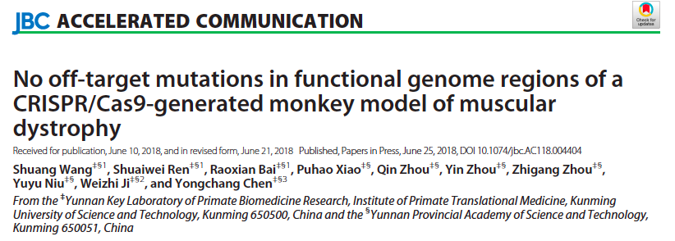
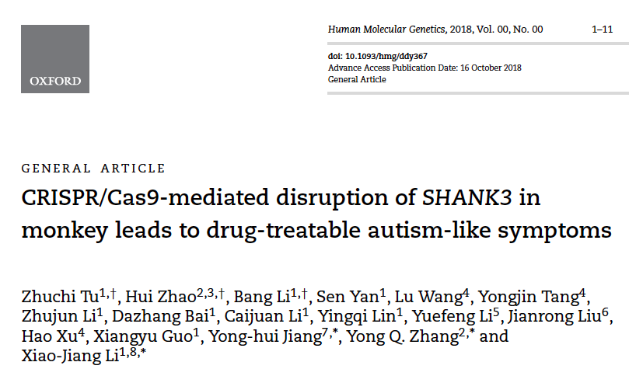
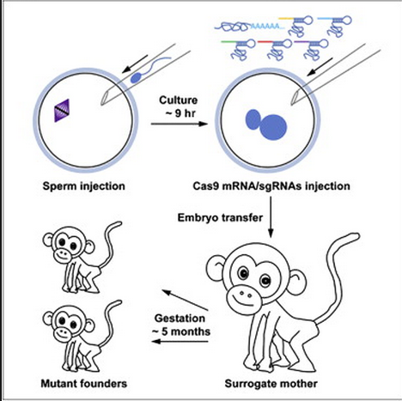
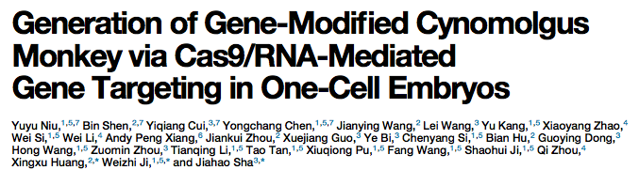
Genome editing in embryos (mice to monkeys)
Mice
Monkeys

Slide 13
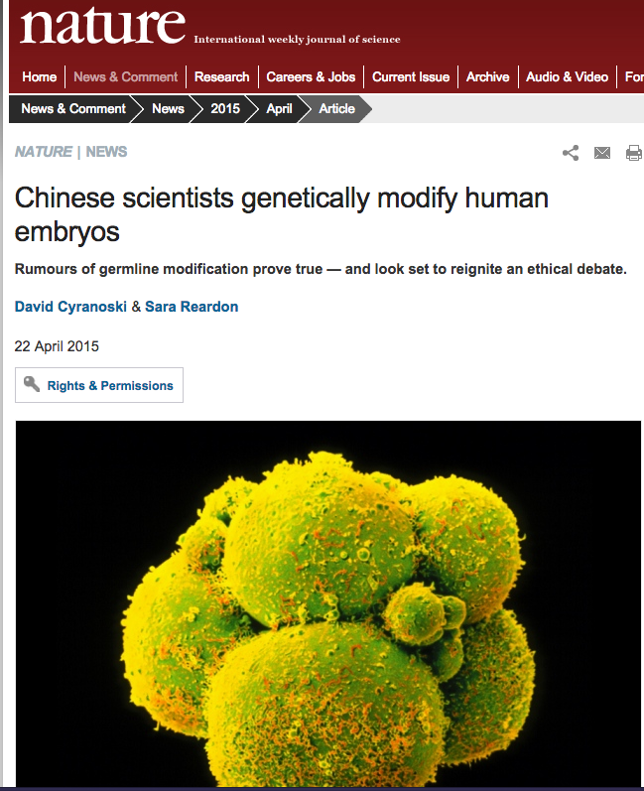
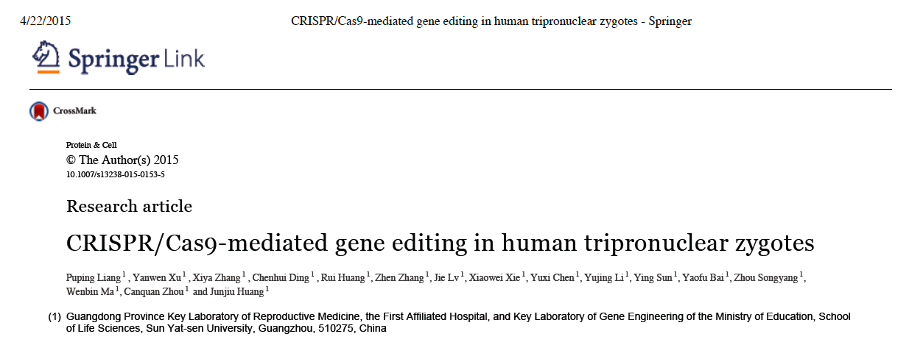

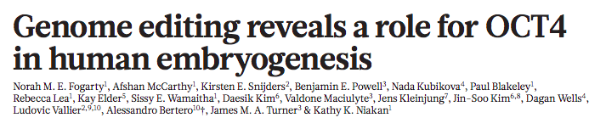
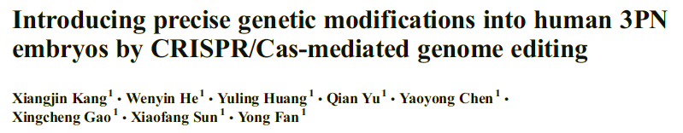
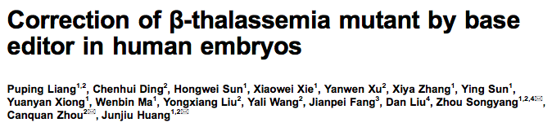
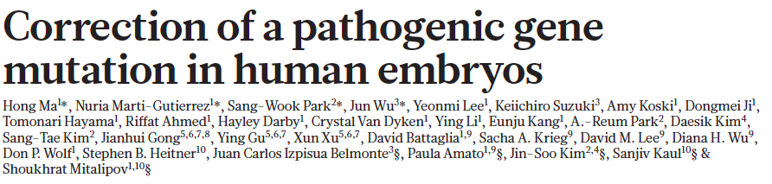


Human embryos
Online April 6, 2016

Slide 14
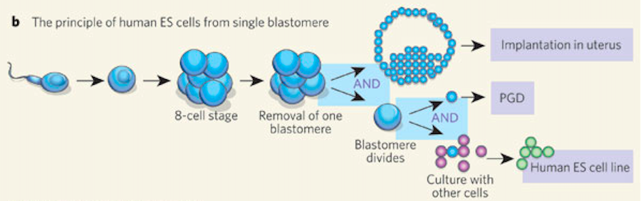
Can embryos be effectively assessed for fidelity of gene editing/ safety?
Trophectoderm biopsy
Mosaicism
X
X
X
X
X
Genome editing
Medicine: Blastomeres and stem cells, Joe Leigh Simpson
Nature 444, 432-435(23 November 2006) doi:10.1038/444432a
Genetic QC
Functional
Assessments
Epigenetic QC

Slide 15
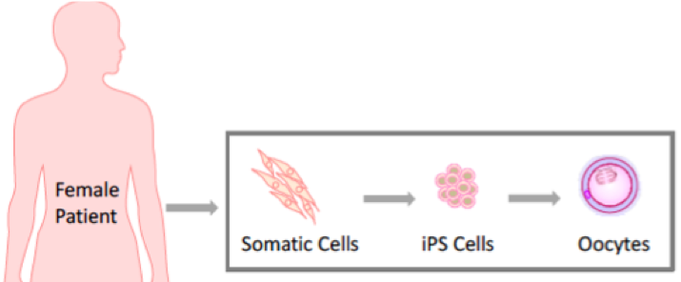
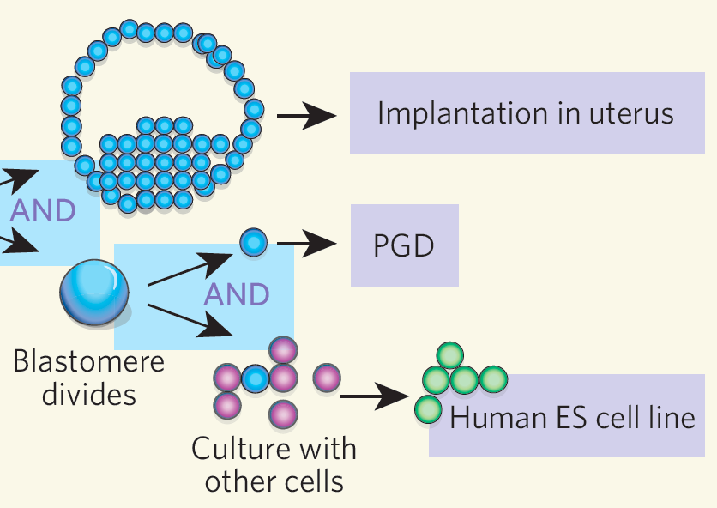
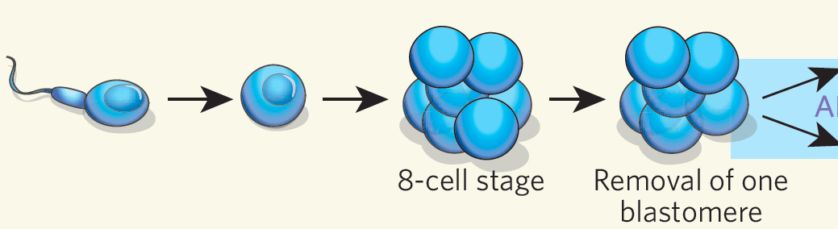
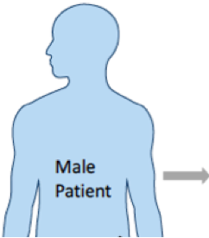
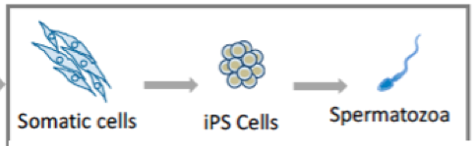
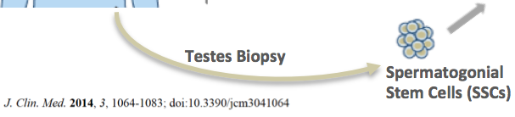
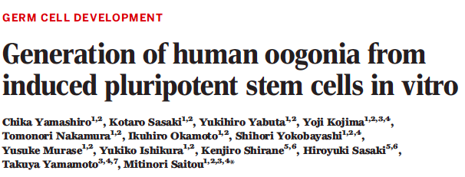
Safe Gene Editing in Embryos? Editing in pluripotent stem cells coupled to in vitro gametogenesis
Skin or blood cells → reprogrammed to iPS cells
iPS cells subjected to gene editing – analysed to be safe
iPS cells turned into eggs and sperm in a dish, used for IVF
IVF
Sperm and eggs have been made from mouse iPS cells…
and mice have been born
Figures adapted from Simpson JL Nature 2006 and Ishii T J Clin Med 2014

Slide 16
A responsible pathway for clinical translation
Scientific consensus on optimal method for genome editing in embryos
Stage and methodology for maximizing on target editing, minimizing mosaicism
Methods to enable comprehensive assessment of genetic and functional outcome
Agreement on methods to evaluate efficacy, consensus on standards
Definition of standards of technical competence for investigators
ISSCR Guidelines specify importance of relevant expertise of investigators…”Appropriate expertise and/or training of the investigators to perform the stated experiments must be ascertained in order to ensure the optimal use of research materials.” (ISSCR Guidelines, p6 May 2016)
Needed: A well defined translational pathway
Time for formal study group to define procedural standards for genome editing
Considerations of permissible “first in human” indications

Slide 17


Are there compelling medical indications?
?
Disease prevention
Huntington’s
Tay Sach’s
Cystic Fibrosis
Sickle cell anemia
Modifying Disease Risk
HIV resistance (CCR5)
Heart disease (PCSK9)
Alzheimer’s (APP A673T/+)
Cancer (BRCA1/2)
Resistance to global pandemics…
“Enhancements”
Muscularity (MSTN)
Height, skin color
Learning and memory https://www.dnalc.org/view/1390-Genes-for-Learning-and-Memory.html
Consider alternatives…
IVF, genetic diagnosis
Somatic therapy
When no alternative…
Couples, both affected
Infertility
Permissible vs impermissible applications?

Slide 18
Encouraging active engagement of the research and clinical community
Self-regulation by scientists is a long-standing professional norm
Essential elements of self-regulation:
Transparency
Willing participation of scientists and practitioners

Slide 19


Slide 20
The criteria include:
absence of reasonable alternatives;
restriction to preventing a serious disease or condition;
restriction to editing genes that have been convincingly demonstrated to cause or strongly predispose to that disease or condition;
restriction to converting such genes to versions that are prevalent in the population and are known to be associated with ordinary health with little or no evidence of adverse effects;
availability of credible pre-clinical and/or clinical data on risks and potential health benefits of the procedures;
during the trial, ongoing, rigorous oversight of the effects of the procedure on the health and safety of the research participants;
comprehensive plans for long-term multigenerational follow-up that still respect personal autonomy;
maximum transparency consistent with patient privacy;
continued reassessment of both health and societal benefits and risks, with broad, ongoing participation and input from the public; and
reliable oversight mechanisms to prevent extension to uses other than preventing a serious disease or condition.
“broad participation and input by the public, along with ongoing reassessment of both health and societal benefits and risks, should be a condition for moving clinical trials forward.”

